Slide 1
SAT Solving
Basic components

Slide 2
Why SAT?
Fundamental problem from theoretical point of view
Cook theorem, 1971: the first NP-complete problem.
Numerous applications:
Solving any NP problem...
Verification: Model Checking, theorem-proving, ...
AI: Planning, automated deduction, ...
Design and analysis: CAD, VLSI
Physics: statistical mechanics (models for spin-glass material)

Slide 3
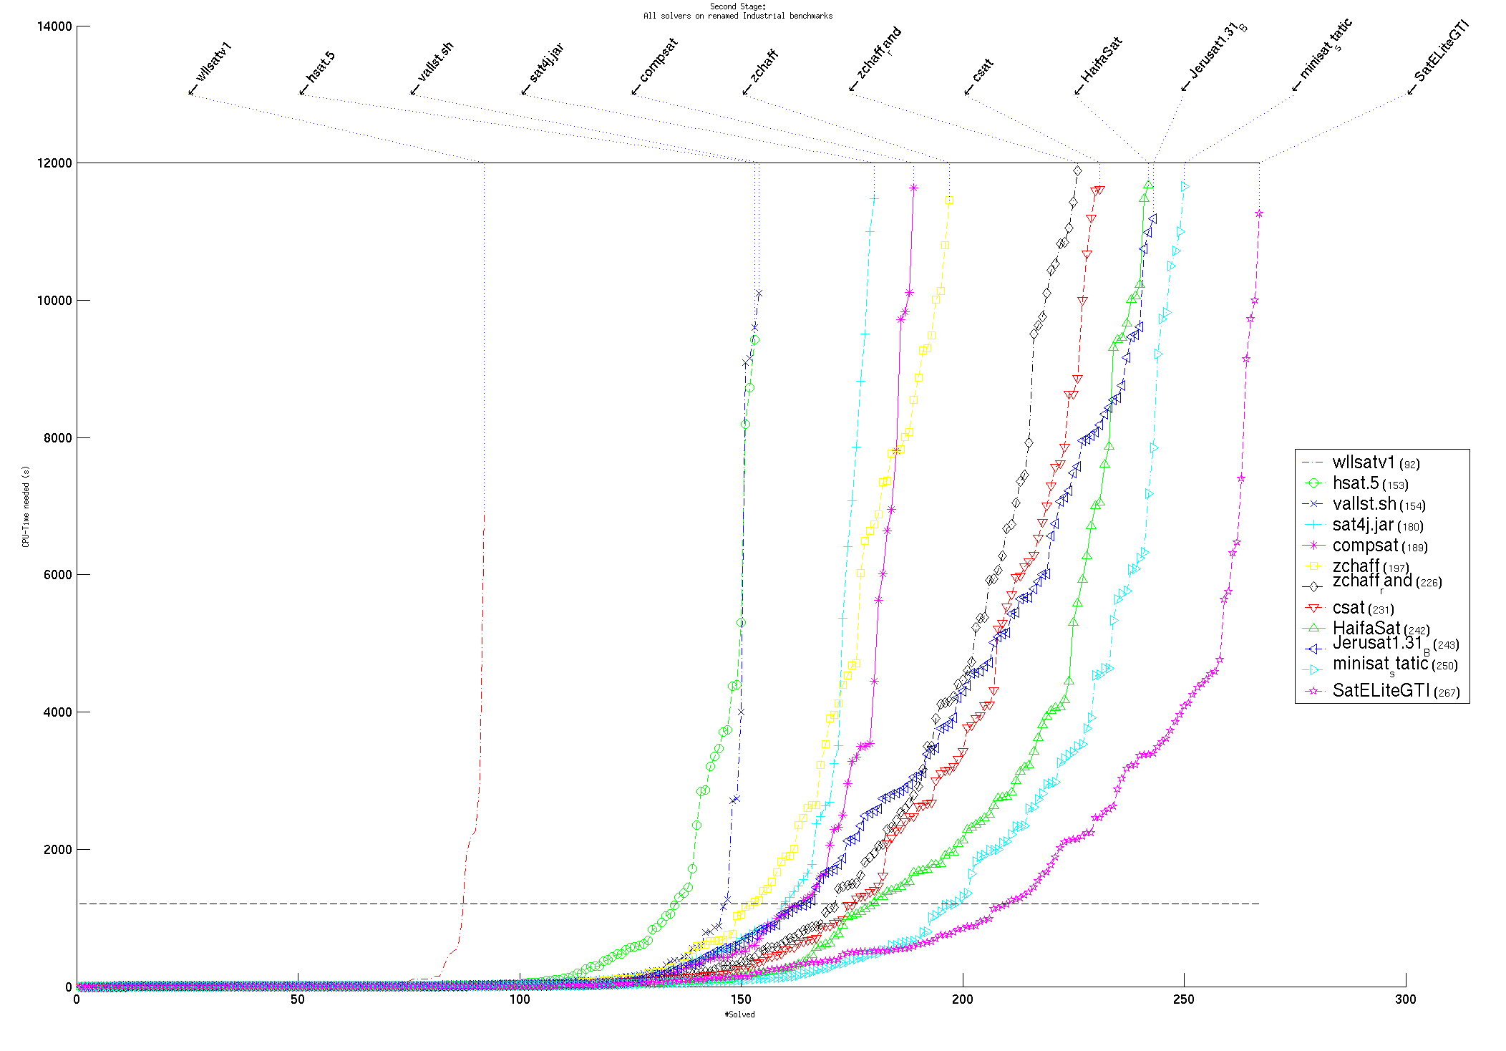
The SAT competitions

Slide 4
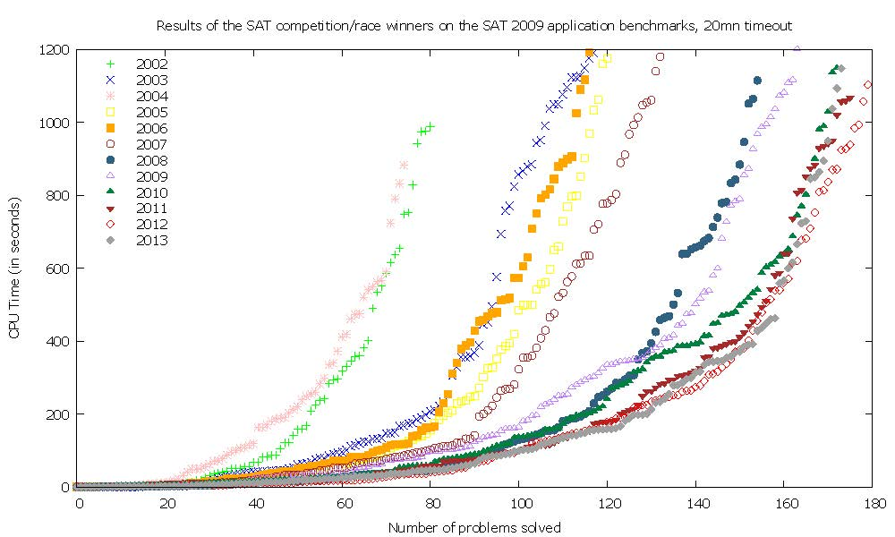
Comparing the annual competition winners Same (single-core) hardware, same benchmarks. (D. le-berre ©)

Slide 5
(CNF) SAT basic definitions: literals
A literal is a variable or its negation.
Var(l) is the variable associated with a literal l.
A literal is called negative if it is a negated variable, and positive otherwise.

Slide 6
SAT basic definitions: literals
If var(l) is unassigned, then l is unresolved.
Otherwise, l is satisfied by an assignment α if α(var(l)) = 1 and l is positive, or α(var(l)) = 0 and l is negative, and unsatisfied otherwise.

Slide 7
SAT basic definitions: clauses
The state of an n-long clause C under a partial assignment α is:
Satisfied if at least one of C’s literals is satisfied,
Conflicting if all of C’s literals are unsatisfied,
Unit if n-1 literals in C are unsatisfied and 1 literal is unresolved, and
Unresolved otherwise.

Slide 8
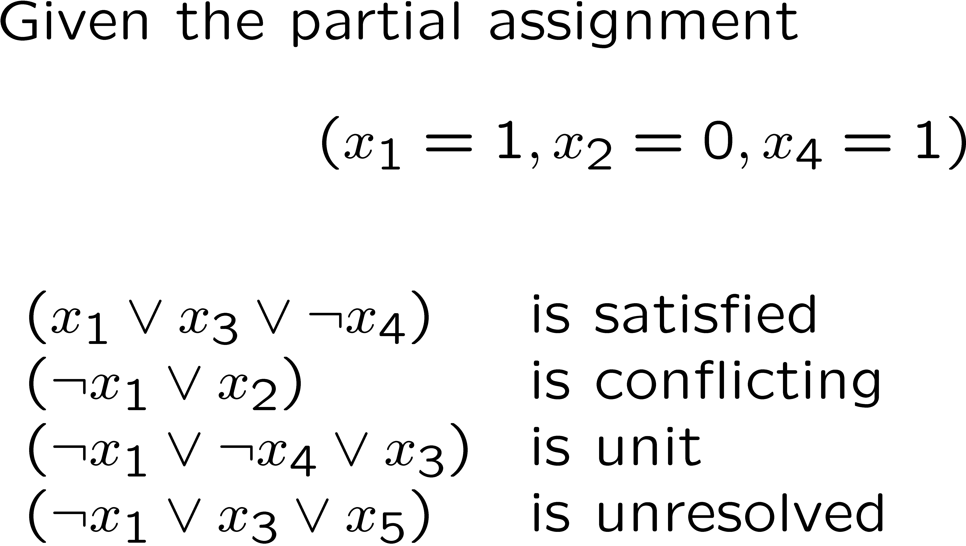
SAT basic definitions: clauses
Example

Slide 9
SAT basic definitions: the unit clause rule
The unit clause rule: in a unit clause the unresolved literal must be satisfied.

Slide 10
Basic Backtracking Search
Organize the search in the form of a decision tree
Each node corresponds to a decision
Depth of the node in the decision tree is called the decision level
Notation: x=v@d x is assigned v 2 {0,1} at decision level d

Slide 11
Backtracking Search in Action
ω₁ = (x₂ ∨ x₃)
ω₂ = (¬x₁ ∨ ¬x₄)
ω₃ = (¬x₂ ∨ x₄)
x₁
x₁ = 1@1
⇒ x₄ = 0@1
x₁ = 0@1
⇒ x₂ = 0@1
⇒ x₃ = 1@1
x₂
x₂ = 0@2
⇒ x₃ = 1@2
{(x₁,1), (x₂,0), (x₃,1) , (x₄,0)}
{(x₁,0), (x₂,0), (x₃,1)}
No backtrack in this example, regardless of the decision!
Notes:
Say which step is which.

Slide 12
Backtracking Search in Action
Add a clause
ω₁ = (x₂ ∨ x₃)
ω₂ = (¬x₁ ∨ ¬x₄)
ω₃ = (¬x₂ ∨ x₄)
ω₄ = (¬x₁ ∨ x₂ ∨ ¬x₃)
x₁
x₁ = 0@1
x₁ = 1@1
⇒ x₄ = 0@1
x₂
⇒ x₂ = 0@1
⇒ x₃ = 1@1
conflict
x₂ = 0@2
⇒ x₃ = 1@2
{(x₁,0), (x₂,0), (x₃,1)}

Slide 13
A Basic SAT algorithm (DPLL-based)
Choose the next
variable and value.
Return False if all
variables are assigned
While (true)
{
if (!Decide()) return (SAT);
while (!BCP())
if (!Resolve_Conflict()) return (UNSAT);
}
Apply unit clause rule.
Return False if reached
a conflict
Backtrack until
no conflict.
Return False if impossible

Slide 14
A Basic SAT algorithm (DPLL-based)
Apply the unit clause rule until convergence.
if reached a conflict:
if dl=0 Abort(“UNSAT”);
return false;
while (true) {
while (!BCP()) { backtrack(analyze(conflicting_clause));
}
if (!decide()) {
PrintAssignment();
Abort("SAT");
}
}
Apply learning.
return backtrack level.
Choose next variable and value.
Return false if all variables are assigned
BCP = Boolean Constraints Propagation

Slide 15
Agenda
Modeling problems in Propositional Logic
SAT basics
Decision heuristics
Non-chronological Backtracking
Learning with Conflict Clauses
SAT and resolution
More techniques: decision heuristics, deduction.

Slide 16
Decision heuristics DLIS (Dynamic Largest Individual Sum)
Maintain a counter for each literal: in how many unresolved clauses it appears ?
Decide on the literal with the largest counter.
Requires O(#literals) queries for each decision.

Slide 17
Decision heuristics Jeroslow-Wang method
Compute for every clause ω and every literal l:
J(l) :=
Choose a variable l that maximizes J(l).
This gives an exponentially higher weight to literals in shorter clauses.

Slide 18
Decision heuristics MOM (Maximum Occurrence of clauses of Minimum size).
Let f*(x) be the # of unresolved smallest clauses containing x. Choose x that maximizes:
(f*(x) + f*(:x)) * 2^{k} + f*(x) * f*( :x)
k is chosen heuristically.
The idea:
Give preference to satisfying small clauses.
Among those, give preference to balanced variables
Example: f*(x) = 3, f*(:x) = 3 is better than f*(x) = 1, f*(:x) = 5.

Slide 19
Pause...
We will see other (more advanced) decision Heuristics soon.
These heuristics are integrated with a mechanism called Learning with Conflict-Clauses, which we will learn next.

Slide 20
Agenda
Modeling problems in Propositional Logic
SAT basics
Decision heuristics
Non-chronological Backtracking
Learning with Conflict Clauses
SAT and resolution
More techniques: decision heuristics, deduction.

Slide 21
Implication graphs and learning
Current truth assignment: {x₉=0@1 ,x₁₀=0@3, x₁₁=0@3, x₁₂=1@2, x₁₃=1@2}
Current decision assignment: {x₁=1@6}
ω₁ = (¬x₁ ∨ x₂)
ω₂ = (¬x₁ ∨ x₃ ∨ x₉)
ω₃ = (¬x₂ ∨ ¬x₃ ∨ x₄)
ω₄ = (¬x₄ ∨ x₅ ∨ x₁₀)
ω₅ = (¬x₄ ∨ x₆ ∨ x₁₁)
ω₆ = (¬x₅ ∨ ¬ x₆)
ω₇ = (x₁ ∨ x₇ ∨ ¬x₁₂)
ω₈ = (x₁∨ x₈)
ω₉ = (¬x₇ ∨ ¬x₈ ∨ ¬ x₁₃)
x₁₀=0@3
x₂=1@6
ω₄
x₅=1@6
ω₁
ω₄
ω₃
ω₆
x₁=1@6
x₄=1@6
ω₆
κ
conflict
ω₃
ω₂
ω₅
ω₂
ω₅
x₆=1@6
x₃=1@6
x₉=0@1
x₁₁=0@3
1. Learn the conflict clause ω₁₀ : (:x₁ Ç x₉ Ç x₁₁ Ç x₁₀)
2. Backtrack to the 2nd largest dec. level in this clause (3) without erasing it

Slide 22
Non-chronological backtracking
3
Decision level
Which assignments caused
the conflicts ?
x₉= 0@1
x₁₀= 0@3
x₁₁= 0@3
x₁= 1@6
Backtrack to decision level 3
And imply x₁ = 0
4
These assignments
Are sufficient for
Causing a conflict.
5
x₁
6
κ
Non-chronological
backtracking

Slide 23
Let’s continue…
ω₁ = (¬x₁ ∨ x₂)
ω₂ = (¬x₁ ∨ x₃ ∨ x₉)
ω₃ = (¬x₂ ∨ ¬x₃ ∨ x₄)
ω₄ = (¬x₄ ∨ x₅ ∨ x₁₀)
ω₅ = (¬x₄ ∨ x₆ ∨ x₁₁)
ω₆ = (¬x₅ ∨ ¬ x₆)
ω₇ = (x₁ ∨ x₇ ∨ ¬x₁₂)
ω₈ = (x₁∨ x₈)
ω₉ = (¬x₇ ∨ ¬x₈ ∨ ¬ x₁₃)
ω₁₀ : (: x₁ Ç x₉ Ç x₁₁ Ç x₁₀)
x₁₃=1@2
x₉=0@1
x₈=1@3
ω₉
ω₁₀
ω₈
x₁₀=0@3
ω₉
x₁=0@3
κ’
ω₁₀
ω₉
ω₁₀
ω₇
x₁₁=0@3
ω₇
x₇=1@3
Due to the conflict clause
x₁₂=1@2
Learn the conflict clause ω₁₁ : (:x₁₃ Ç x₉ Ç x₁₀ Ç x₁₁ Ç :x₁₂)
Backtrack to the 2nd largest decision level in this clause (2).
Notes:
Note that in this case we did not learn an asserting clause.
The asserting clause can be found only if we look at the whole implication graph of level 3.

Slide 24
Non-chronological backtracking
So the rule is: backtrack to the 2nd largest decision level in the conflict clause.
Q: What if there is one literal in the clause?
A: backtrack to decision level 0
Q: It seems to waste work, since it erases assignments in decision levels higher than dl, unrelated to the conflict.
A1: indeed. But allows the SAT solver to redirect itself with the new information.
A2: we can also save the last assignment for next time (“phase saving”)
Notes:
If, at a later stage, the solver backtracks to $dl$ again, there will be no decision to erase, which will lead to another conflict and immediate backtracking to a
decision level shallower that $dl$. For example, if the asserting clause at level dl+3 asserts x=1@dl, since currently x=0@dl and we do not erase it, there is an immediate conflict, which leads to further conflicts.
Alternatively: if we do erase all implications at dl, then the asserting clause will assert x=1, but there is still the conflict clause that at dl asserts x=0, hence a conflict.

Slide 25
Conflict-driven Backtracking
x₁ = 0
x₂ = 0
x₅ = 1
x₃ = 1
x₇ = 1
x₉ = 1
x₄ = 0
x₃ = 1
x₆ = 0
...
x₅ = 0
x₉ = 0

Slide 26
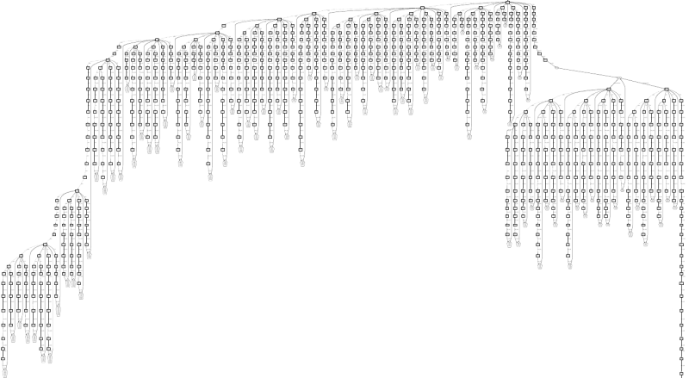
Conflict-driven Backtracking
Decision level

Slide 27
Conflict-driven Backtracking

Slide 28
Progress of a SAT solver
work invested in refuting x=1
(some of it seems wasted)
C
x=1
Refutation of x=1
C₅
C₂
Decision
Level
C₁
C₄
BCP
C₃
Decision
Time
Conflict

Slide 29
More Conflict Clauses
Def: A Conflict Clause is a redundant clause learned during conflict-analysis
Let L be a set of literals labeling nodes that form a cut in the implication graph, separating the conflict node from the roots.
Claim: Ç_{l2L}:l is a Conflict Clause.
x₁₀=0@3
2
1. (x₁₀ Ç :x₁ Ç x₉ Ç x₁₁)
1
x₂=1@6
ω₄
x₅=1@6
2. (x₁₀ Ç :x₄ Ç x₁₁)
ω₁
ω₄
ω₃
ω₆
x₁=1@6
x₄=1@6
ω₆
κ
conflict
3. (x₁₀ Ç :x₂ Ç :x₃ Ç x₁₁)
ω₃
ω₂
ω₅
ω₂
ω₅


x₃=1@6
x₆=1@6
x₉=0@1
x₁₁=0@3
3
Notes:
Redundant – does not change the satisfiability

Slide 30
Conflict clauses
How many clauses should we add ?
If not all, then which ones ?
Shorter ones ?
Check their influence on the backtracking level ?
The most “influential” ?
The answer requires two definitions:
Asserting clauses
Unique Implication points (UIP’s)

Slide 31
Asserting clauses
Asserting Clause: a Conflict Clause with a single literal at the largest decision level.
Backtracking (to the right level) makes it a Unit clause.
Modern solvers only consider Asserting Clauses.

Slide 32
Unique Implication Points (UIP’s)
Def: A Unique Implication Point (UIP) is an internal node in the Implication Graph that all paths from the decision to the conflict node go through it.
x₁₀=0@3
ω₄
ω₁
UIP
ω₄
UIP
ω₃
ω₆
x₄=1@6
ω₆
κ
conflict
ω₃
ω₂
ω₅
ω₂
ω₅
x₁₁=0@3

Slide 33
Unique Implication Points (UIP’s)
The First-UIP is the closest UIP to the conflict.
The method of choice: an asserting clause that includes the first UIP.
In this case: (x₁₀ Ç :x₄ Ç x₁₁).
x₁₀=0@3
ω₄
ω₁
UIP
ω₄
UIP
ω₃
ω₆
x₄=1@6
ω₆
κ
conflict
ω₃
ω₂
ω₅
ω₂
ω₅
x₁₁=0@3

